Slide 1
Natural Language Processing 2021-2022 a.y.
Presentation of HWs
HW1 Named Entity Recognition (NER) HW2 Semantic Role Labeling (SRL) HW3 Coreference Resolution (Entity Resolution) | Bota Duisenbay 1849680

Slide 2
HW1
Named Entity Recognition (NER)

Slide 3
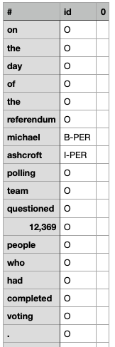
HW1: NER problem formulation
PER person | LOC location | GRP group
CORP corporation | PROD product | CW creative work
Word wise classification into the class
with prefixes indicating position in chunk,
resulting in total of 14 classes (e.g. I-LOC)
B- beginning | I- inside | O- other

Slide 4
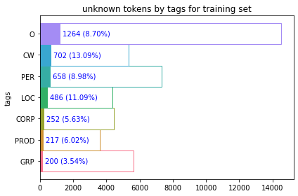
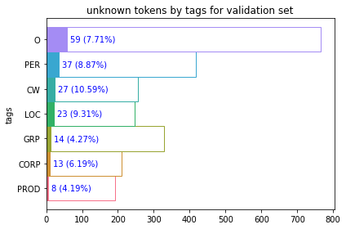
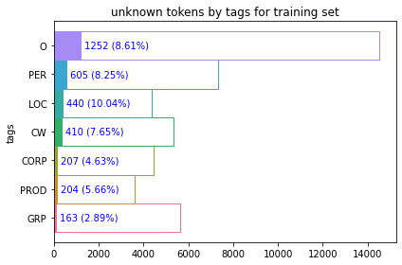
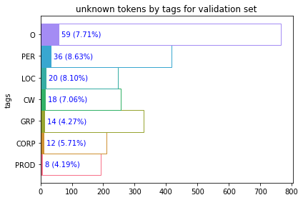
HW1: NER preprocessing
lowercase + special character removal + removal of punctuation at the end of a token
improved for all tags esp for CW 702 -> 410 unk token
!non-alphanumeric word removal
non-English token presence
!stop word removal

Slide 5
HW1: NER preprocessing
Vocabulary - tokens from pre-trained Glove6B model were used
400 000 words 89% coverage additional tokens '<PAD>' (zero tensor), '<UNK>' (avg tensor)
Token:
['it', 'lies', 'approximately', 'north', 'east', 'of', 'bolesławiec', ',', 'and', 'west', 'of', 'the', 'regional', 'capital', 'wrocław', '.']
token2id
[22, 2347, 2129, 195, 324, 5, 149549, 3, 7, 261, 5, 2, 912, 353, 32378, 4]
word embedding
[[50d tensor],[50d tensor], …]
Labels:
['O', 'O', 'O', 'O', 'O', 'O', 'B-LOC', 'O', 'O', 'O', 'O', 'O', 'O', 'O', 'B-LOC', 'O']
label2id
[13, 13, 13, 13, 13, 13, 2, 13, 13, 13, 13, 13, 13, 13, 2, 13]

Slide 6
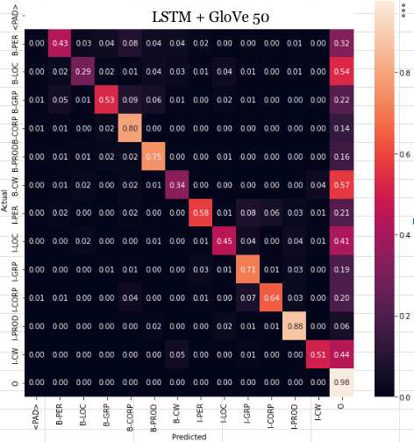
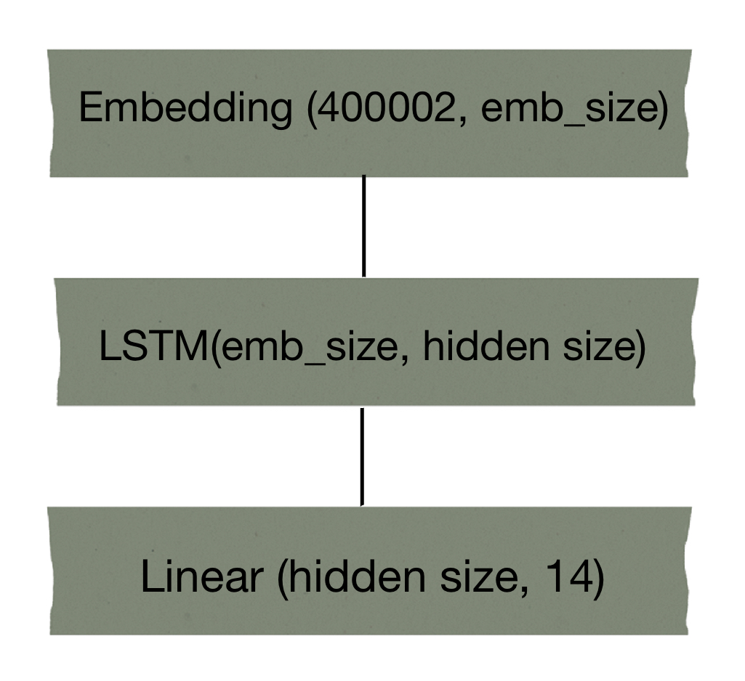
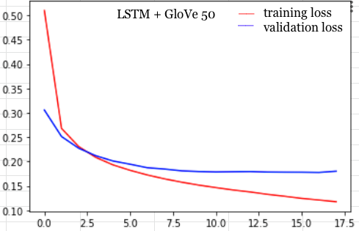
HW1: NER baseline model
hidden size | 128
batch size | 32
embedding size | 50
learning rate | 1e-4
weight decay | 1e-6
optimizer | Adam
1LSTM F = 0.3987
2LSTM F = 0.3982
2LSTM + dropout 0.2 F = 0.4071

Slide 7
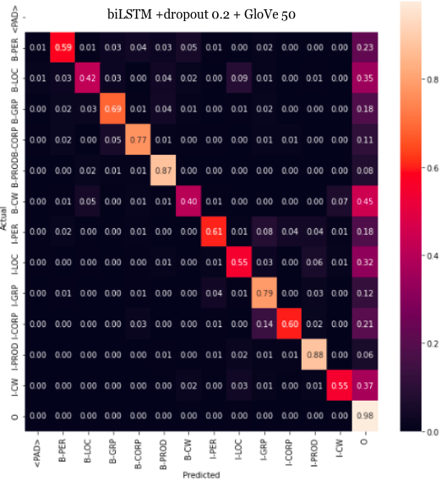
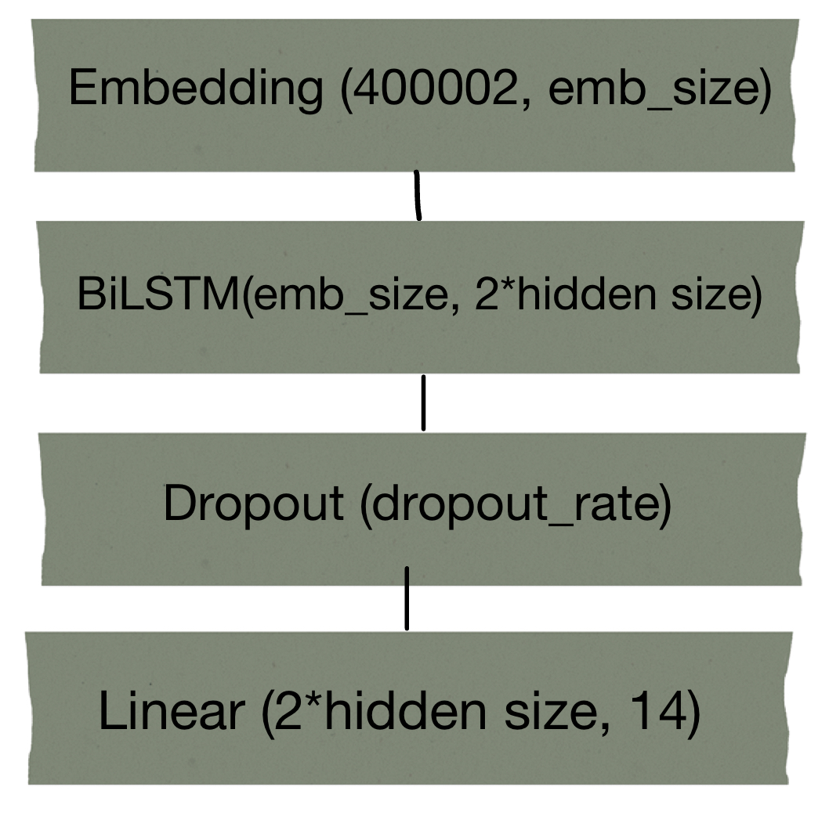
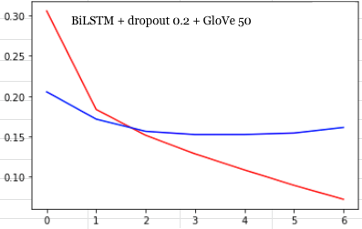
HW1: NER model 1
hidden size | 256
batch size | 16
embedding size | 50
learning rate | 1e-3
weight decay | 1e-6
optimizer | Adam
dropout | 0.2, 0.4
1 BiLSTM F = 0.4758
2 BiLSTM F = 0.4851

Slide 8
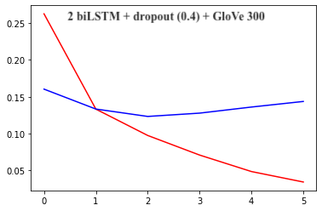
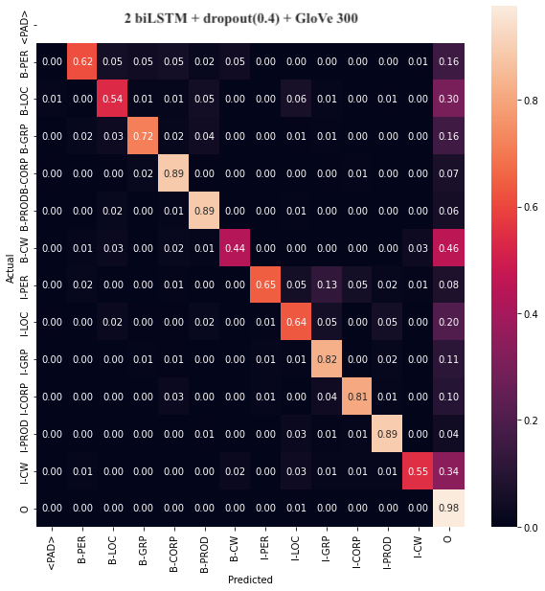
HW1: NER model 2
hidden size | 512
batch size | 16
embedding size | 300
learning rate | 1e-3
weight decay | 1e-6
optimizer | Adam
dropout | 0.4
2 BiLSTM F = 0.5387

Slide 9
conclusion
vocabulary coverage can be improved by simple preprocessing, but needs to be manually checked
vocabulary coverage affects accuracy for a label
performance depends primarily on complexity of network and embedding
when using larger network, dropout not only for regularization, but also improves performance

Slide 10
HW2
Semantic Role Labeling
(SRL)

Slide 11
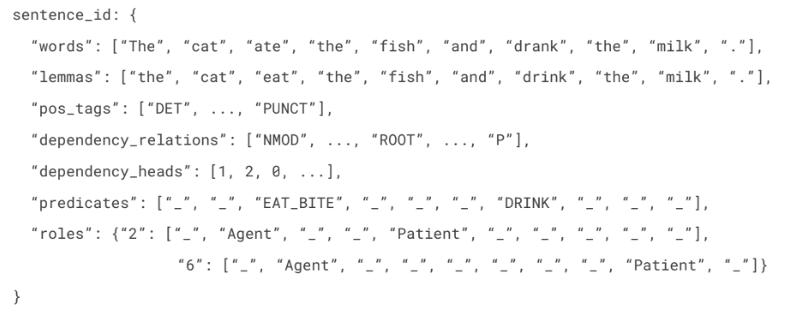
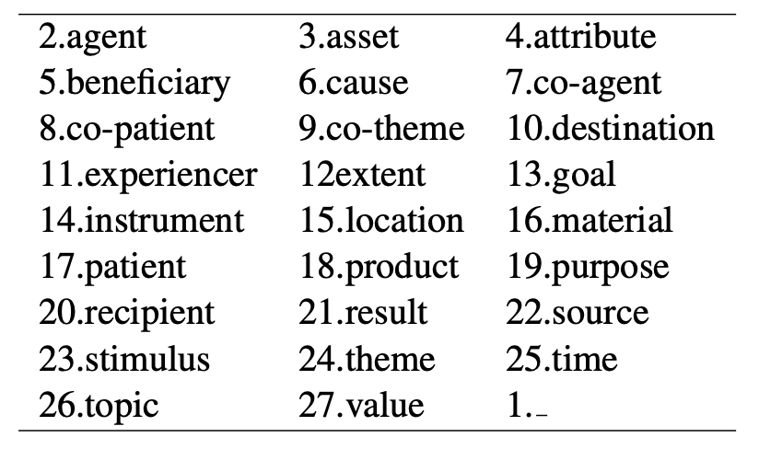
HW2: SRL problem formulation
given a predicate, token wise identification and classification of argument into the roles:

Slide 12
HW2: SRL preprocessing
used only words (lowercase+special character removal), lemmas and roles
extracted predicate words from lemmas given predicate position in roles
a sentence per predicate:
if no predicate present, all labels are ‘-’
if multiple predicates in a single sentence, duplicate for each predicate and associated roles
as a result, increased number of sentences: train 5501->12641; val 1026 -> 2553.
For Glove word embedding:
a sentence is a token-wise concatenation of cleaned word, lemma and predicate word (in case non predicate word - ‘0’)
For BERT:
BERT tokenizer may divide a word into sub words, positions of labels and predicates were aligned to point to the first subword
[CLS] sentence [SEP] predicate-word [SEP]

Slide 13
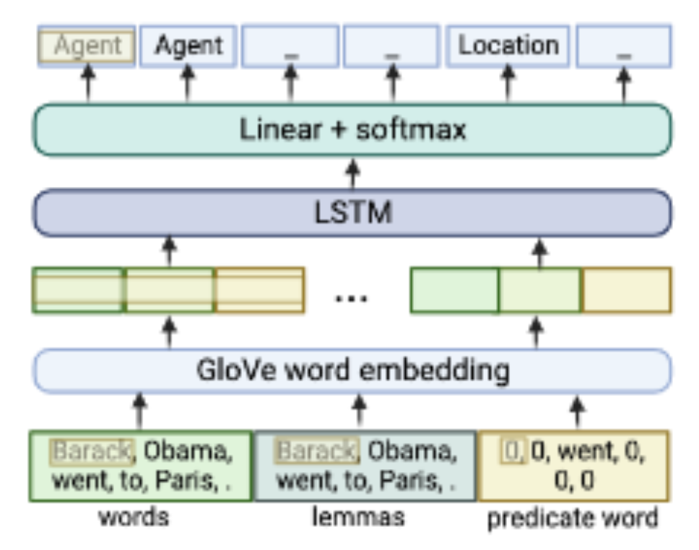
HW2: SRL Glove embedding model
hidden size (LSTM/BiLSTM) | 512 / 256
batch size | 32
embedding size | 100
learning rate | 1e-3
optimizer | Adam

Slide 14
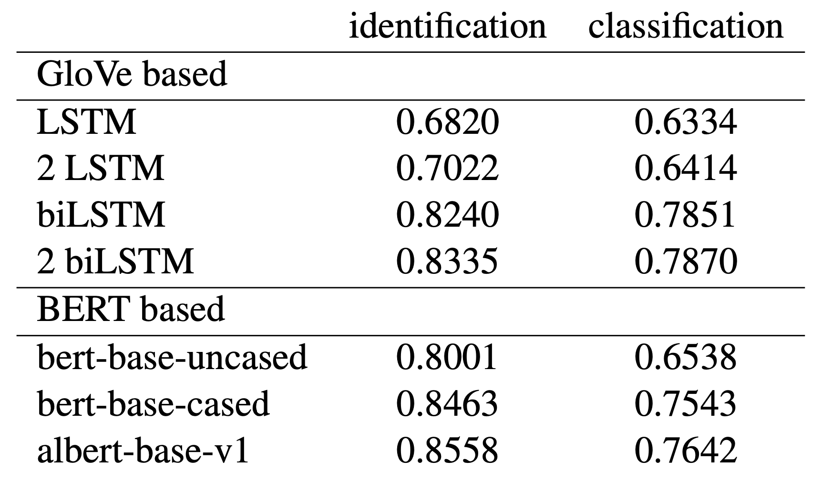
HW2: SRL Glove model results

Slide 15
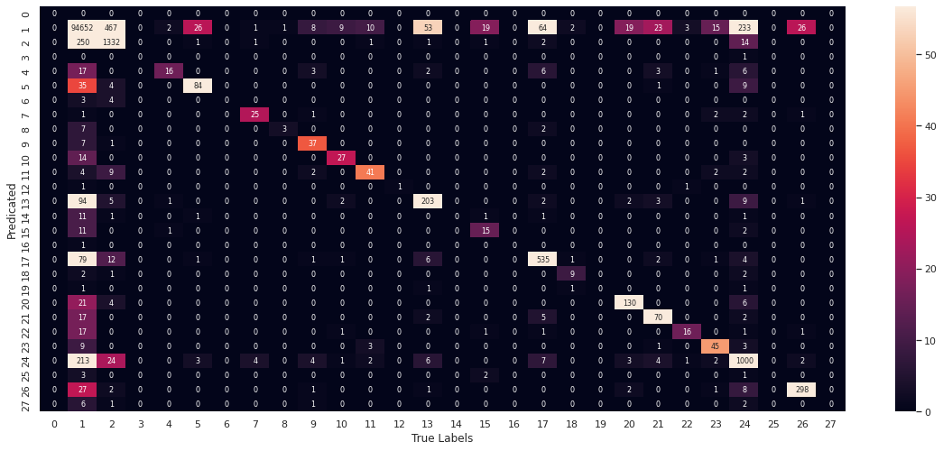
HW2: SRL Glove model results

Slide 16
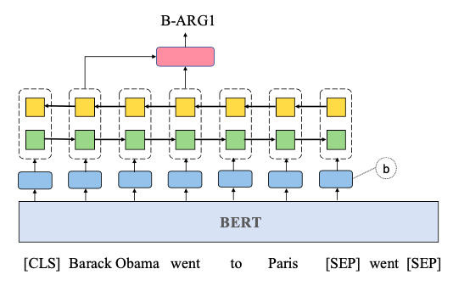
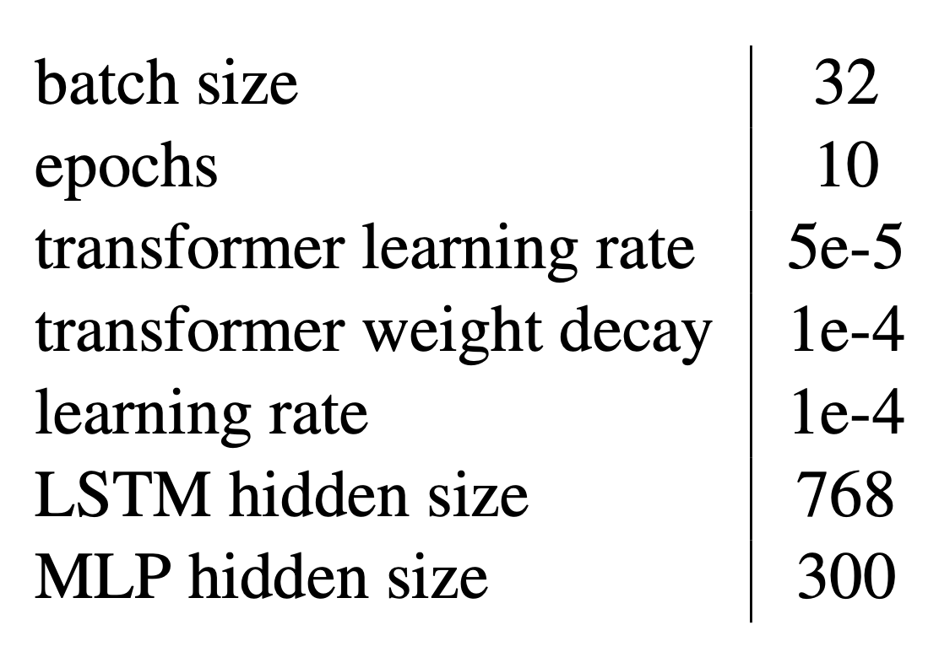
HW2: SRL BERT
[hidden_state (a word) | hidden_state (predicate)] =>
MLP classifier: linear+softmax+linear
BiLSTM
the embedding layer of binary predicate indicator of a fixed size (10)
[11 11 11 11 11] if a word is predicate
[00 00 00 00 00] else
embedding for
[CLS] sent [SEP]

Slide 17
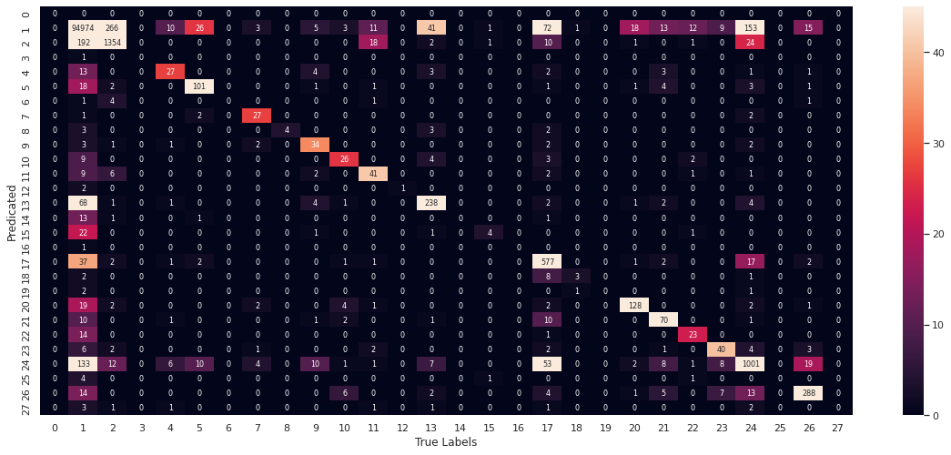
HW2: SRL BERT embedding model

Slide 18
HW2: BERT model results

Slide 19
conclusion
once again proved complexity of the network affects the performance of GloVe based models
for BERT based model,
case sensitive language model results in better score,
reduced version of language models can outperform the original model = > no correlation between network complexity and performance
predicate representation and indication method is crucial
although transformer based models are considered to be more powerful that GloVe, both models made of BiLSTM has shown similar results. This accounts to the difference in predicate indication method in these models

Slide 20
HW3
Coreference Resolution
(Entity resolution)

Slide 21
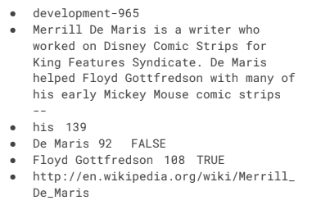
HW3: problem formulation
id
text
pronoun
pronoun offset
entity_A
entity_A offset
is coref A
entity_B
entity_B offset
is_coref_B
linking pronouns to the corresponding entities

Slide 22
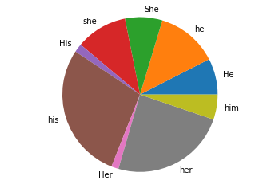
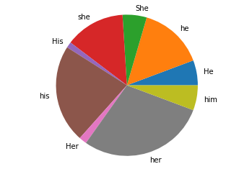
HW3: preprocessing
Given entity words and starting positions, enclosed pronoun and entities with tags <P>,<A>, <B>
...Jose de Venecia III, son of House Speaker <A>Jose de Venecia Jr<A>, alleged that <B>Abalos<B>offered <P>him<P>US $10 million to withdraw his proposal on the NBN project.
Alignment of words’ position after these added tags are important for post-processing
‘Neither’ class added if both is_coref_A and is_coref_B are FALSE
pronoun distribution: train and val sets

Slide 23
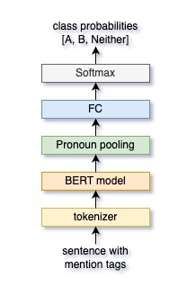
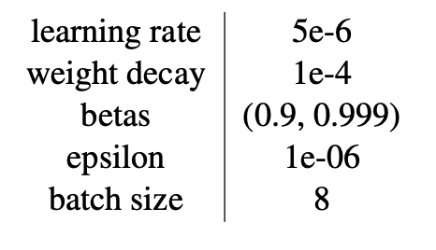
HW3: ProBERT
extracting token representation of the pronoun given its id
optimizer AdamW
dropout 0.1
early stop with tolerance 2 epochs

Slide 24
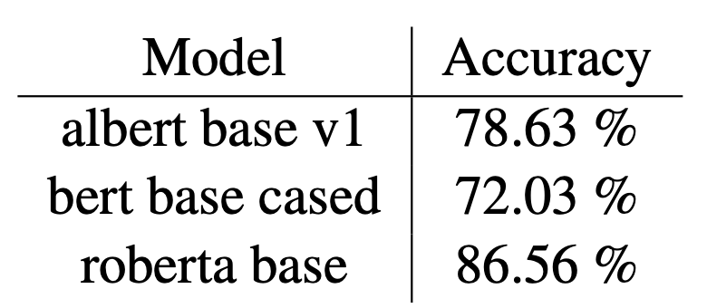
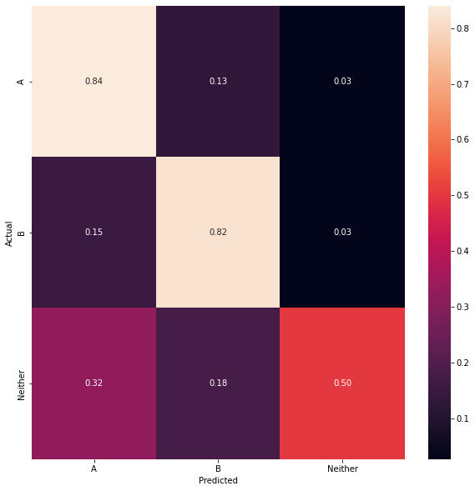
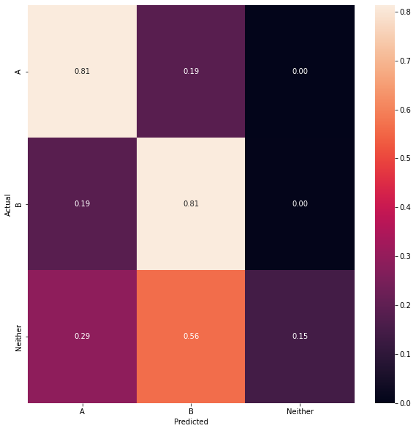
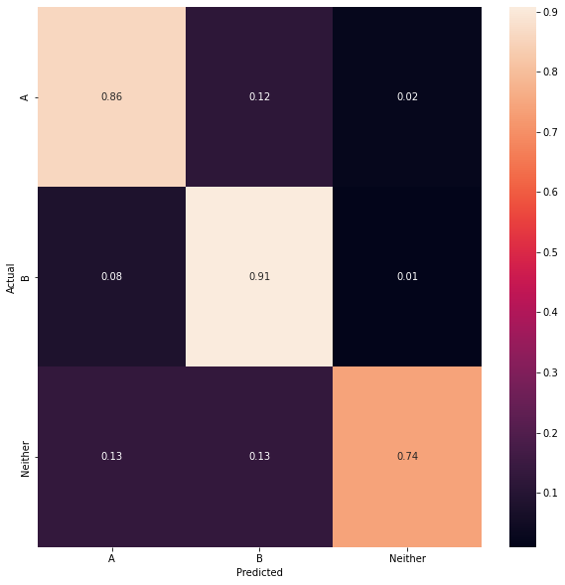
HW3: ProBERT
 | A | B | N
train | 44.4% | 45.1% | 10.5%
test | 41.2% | 45.2% | 13.6%
albert base v1
bert base cased
roberta base

Slide 25
conclusion
based on the performance, encoding pronoun and entity indications using tags found to be efficient
comparing models:
1.8x reduced version of BERT model, Albert performs better than original BERT as expected
Roberta trained on larger corpus (and other differences in training) performs better than both Albert and BERT

